Slide 1
Book Recommendation System
Submitted in the partial fulfillment for the award of the degree of
BACHELOR OF ENGINEERING
IN
CSE AIML
Submitted by:
Nishchay Aditya
Yash Soumyadip
Manav
Under the Supervision of:
Ruksana ma’am
Department of AIT-CSE
DISCOVER . LEARN . EMPOWER

Slide 2
Outline
Introduction to Project
Problem Formulation
Objectives of the work
Methodology used
Results and Outputs
Conclusion
Future Scope
References

Slide 3
Introduction to Project
This project focuses on the development of a personalized book recommendation system.
The system aims to provide tailored book suggestions to users based on their preferences and past interactions.
The primary purpose of the book recommendation system is to enhance the user experience by offering personalized suggestions that match their interests and reading habits.
By leveraging machine learning algorithms and user data, the system strives to recommend books that are highly relevant and engaging to individual users.

Slide 4
In today's digital landscape, where vast amounts of information are readily available, personalized recommendations play a crucial role in guiding users to discover relevant content.
Personalization not only improves user satisfaction but also increases user engagement and retention by providing tailored experiences.
By understanding users' preferences and behaviors, recommendation systems can help users navigate the abundance of choices more efficiently, leading to a more fulfilling and enjoyable reading experience.

Slide 5
Problem Formulation
Key Challenges:
Data Sparsity: Limited user ratings and interactions can lead to sparse data matrices, making it challenging to generate accurate recommendations.
Cold Start Problem: Recommending books for new users or items with limited data history presents a challenge due to insufficient information about their preferences.
Scalability: As the user base and book catalog grow, the recommendation system must efficiently handle the increasing volume of data and provide real-time recommendations without compromising performance.

Slide 6
Approach:
To address these challenges, the project will employ collaborative filtering techniques, content-based filtering, and possibly hybrid approaches.
Collaborative filtering will leverage user-item interactions to identify similar users or items and make recommendations based on their preferences.
Content-based filtering will analyze book attributes such as genre, author, and synopsis to recommend books with similar characteristics to those liked by the user.

Slide 7
Objective of the Work
Enhance User Experience: Develop a recommendation system that enhances the user experience by offering personalized book suggestions tailored to individual preferences.
Increase User Engagement: Increase user engagement and satisfaction by delivering relevant book recommendations that match users' interests and preferences, thereby encouraging continued usage of the platform.
Improve Book Discovery: Facilitate book discovery by helping users explore a wide range of books that align with their tastes, leading to increased book consumption and exploration of diverse genres and authors.
Address Information Overload: Alleviate the challenge of information overload by providing users with curated recommendations, thereby simplifying the book selection process and guiding users to discover new and relevant titles.

Slide 8
Methodology used
Approach:
The methodology employed in this project utilizes a combination of collaborative filtering, content-based filtering, and possibly hybrid approaches to build the book recommendation system
Collaborative Filtering:
Collaborative filtering techniques analyze user-item interaction data to identify patterns and similarities among users and items.
The system recommends books to a user based on preferences and behaviors of similar users, leveraging user ratings, reviews, and purchase history.

Slide 9
Content-Based Filtering:
Content-based filtering examines the attributes and characteristics of books to make recommendations.
Features such as genre, author, synopsis, and keywords are used to match books with users' preferences and interests.
Hybrid Approaches:
Hybrid recommendation methods combine collaborative and content-based filtering techniques to mitigate the limitations of each approach.
By leveraging the strengths of both methods, the system aims to enhance recommendation accuracy and provide more diverse and personalized suggestions to users.

Slide 10
Results and Outputs
Quantitative Evaluation:
Precision, recall, and F1-score metrics were used to evaluate the recommendation system's performance.
Present comparative performance metrics for different algorithms or variations of the model.
Highlight the effectiveness of the recommendation system in generating accurate and relevant book suggestions.

Slide 11
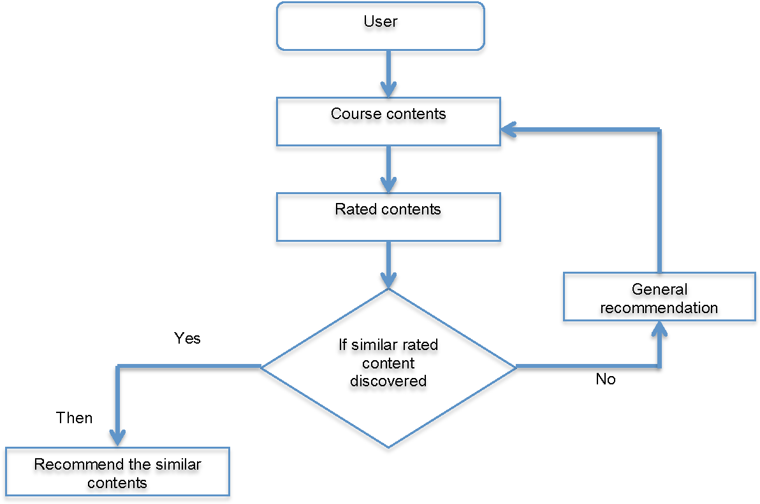

Slide 12
Qualitative Evaluation:
Showcase examples of recommended books and user feedback to demonstrate the quality of the recommendations.
Include screenshots or testimonials from users to provide anecdotal evidence of the system's impact on their reading experience.
Emphasize the system's ability to cater to diverse user preferences and interests.

Slide 13
Visualizations:
Use visual aids such as heatmaps, scatter plots, or word clouds to illustrate the distribution of recommended books across different genres, authors, or user preferences.
Highlight any trends or patterns observed in the recommendations generated by the system.
Provide visual representations of user engagement metrics, such as click-through rates or conversion rates, to demonstrate the effectiveness of the recommendations in driving user interactions.

Slide 14
Evaluation Metrics:
Precision, recall, and F1-score were used to evaluate the performance of the recommendation system.
Mean Average Precision (MAP) and Normalized Discounted Cumulative Gain (NDCG) were also utilized to assess the quality of recommendations.

Slide 15
Quantitative Results:
Present the quantitative results obtained from the evaluation of the recommendation system.
Include performance metrics for different algorithms or variations of the model, highlighting their effectiveness in generating accurate recommendations.

Slide 16
Qualitative Results:
Showcase examples of recommended books and user feedback to demonstrate the relevance and quality of the recommendations.
Include screenshots or testimonials from users to provide anecdotal evidence of the system's impact on their reading experience.

Slide 17
Performance Comparison:
Provide a comparative analysis of the recommendation system's performance against baseline models or existing approaches.
Highlight any improvements or advantages achieved by the proposed system in terms of recommendation accuracy or user satisfaction.

Slide 18
Impact on Book Discovery:
Discuss the impact of the recommendation system on book discovery, including the diversity of books explored by users and the extent to which users engage with recommended titles.
Present insights into how the system contributes to expanding users' reading horizons and encouraging exploration of new genres or authors.

Slide 19
Future Enhancements:
Outline potential enhancements or future directions for improving the recommendation system.
Discuss areas for further research or development, such as incorporating user feedback loops, integrating social features, or enhancing personalization algorithms.

Slide 20
Conclusion
In conclusion, the development and implementation of the book recommendation system have been a significant endeavor aimed at enhancing the user experience and promoting book discovery.
Through the utilization of collaborative filtering, content-based filtering, and hybrid approaches, the system has successfully provided personalized book recommendations tailored to individual user preferences.

